Slide 1
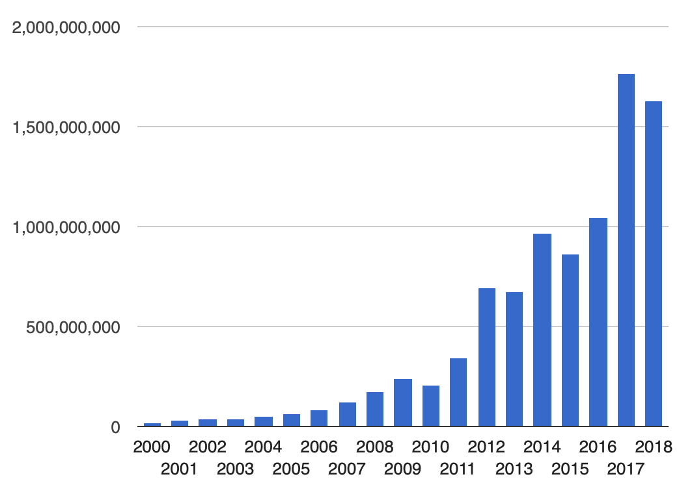
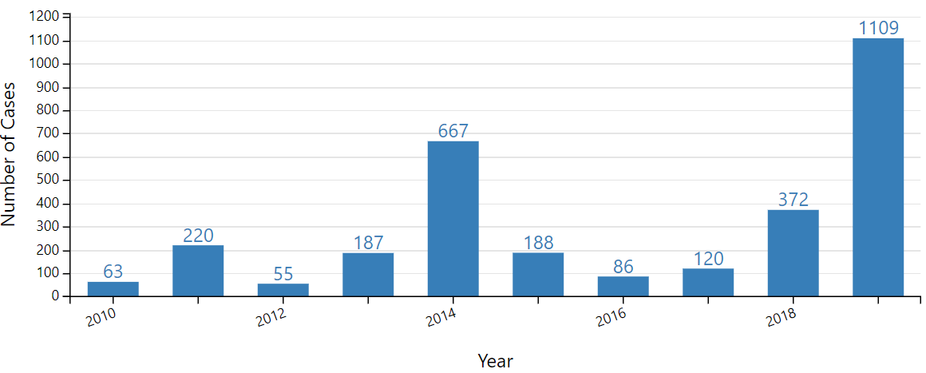
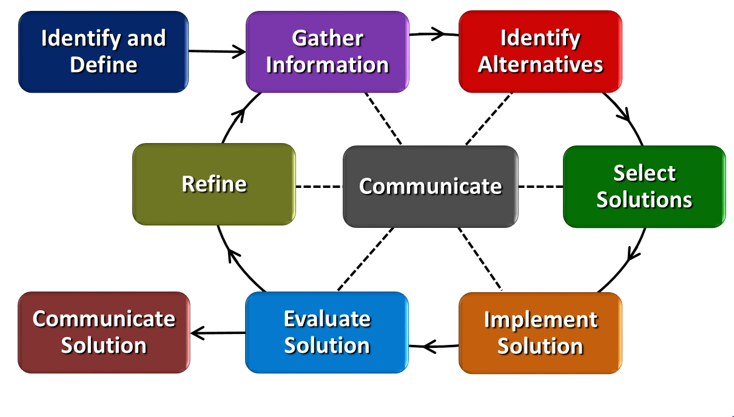
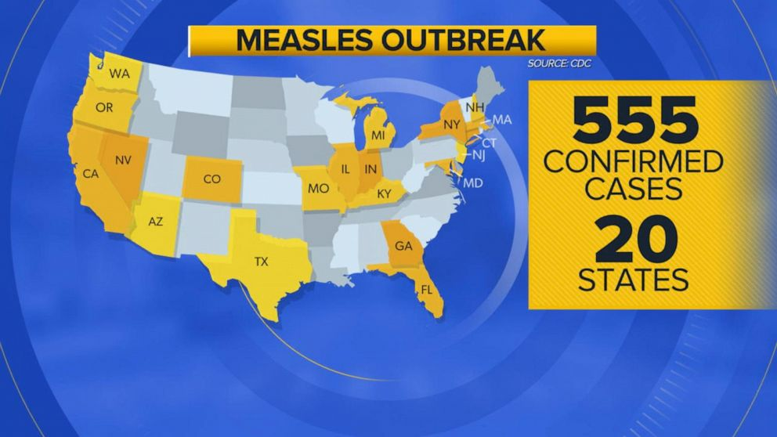
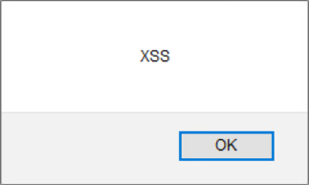
Secure Software Development Eli Rolfes Holmes High School, Algebra II
RET is funded by the National Science Foundation, grant # EEC-1710826
Web Application Security
Decision-making Algorithms
Responding to Crises
Messaging
Compose Message
Subject
Body
Inbox / Outbox
Reply
Open Message
Capturing the intuitive nature of human decision-making pathways applies beyond web applications.
Central Idea
How can we use functions to make informed decisions?
Proper plaining is vital for handling any sort of crisis.
Figure 1: Total Number of Websites
According to SiteLock, 4.44% of websites have at least one cross-site scripting (XSS) vulnerability.
In other words, there are over 7,000,000 vulnerable websites (XSS).
How does technology help us answer complex problems?
Health Epidemics
XSS Research
Inject code
Log in as HCP
Log in as patient
Verify code
Work was done in a local sandbox server
Engineering Design Process
Request an appointment
Insights from human intuition are used to help computer algorithms detect vulnerabilities in web applications where code can be injected.
Injected code displayed pop-up boxes with the message “XSS”
Measles cases by year.
View
appointment requests

